Slide 1
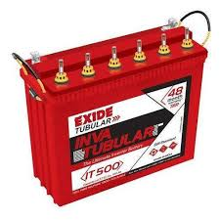
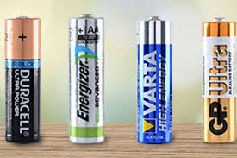
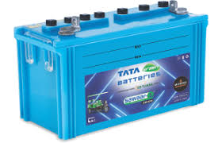
BATTERY

Slide 2
A battery is a device which converts chemical energy into electrical energy.
In other words, a battery is an arrangement of several electrochemical cells is connected in series, which can be used as a source of direct electric current. That is, it contains several anodes and cathodes.
Example - The ordinary 6 volt Lead storage battery is a combination of three 2 volt cells connected in series.
A useful battery should fulfil the following requirements
1. It should be light and compact for easy transport.
2. It should have long life both when it is being used and when it is not used.
3. The voltage of the battery should not vary appreciably during its use.

Slide 3
Classification of batteries
Batteries are broadly classified into the following three categories. They are
1. Primary battery (or) Primary cells
2. Secondary battery (or) Secondary cells
3. Flow battery (or) Fuel cells
Primary battery
The battery in which cell reaction is not reversible is primary battery. i.e. The electrode reaction cannot be reversed by passing an external electrical energy.
In the primary batteries the reaction occurs only once and after use over a period of time battery becomes dead and cannot be reused again. Therefore, they are not chargeable.
Examples: Dry cells, Alkaline battery, Mercury cells.

Slide 4
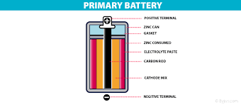

Slide 5
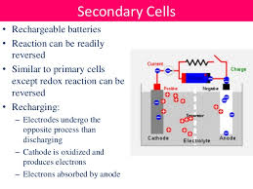
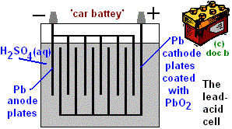
Secondary battery
The battery in which cell reaction is reversible is secondary battery. i.e. The electrode reaction can be reversed by passing an external electrical energy. Secondary batteries are one which can be recharged and reused repeatedly. These are called storage cells or accumulators.
Examples: Lead acid storage cells, Nickel Cadmium cells, Lithium battery.

Slide 6
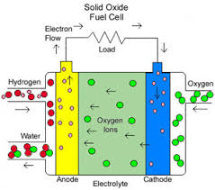
Flow batteries
In these batteries, the materials (reactants, products and electrolytes) continuously pass through the cell, which is simply an electrochemical cell that converts chemical energy of the fuels directly into electrical energy without combustion.
Fuel + Oxygen Oxidation products + Electricity
Example: Hydrogen – Oxygen fuel cell

Slide 7
Differences between primary and secondary batteries
SNO | Primary batteries | Secondary batteries
1 | Irreversible batteries | Reversible batteries
2 | It can be used only once | It can be used, recharged and reused
3 | They are cheap | They are costlier
4 | Initial cost is low | Initial cost is very high

Slide 8
ALKALINE BATTERY
An alkaline battery is an improved form of the dry cell.
In this cell, the electrolyte is a concentrated solution of KOH (35 – 50%).
As the electrolyte in this cell is an alkali, it is called alkaline battery.
Anode: Zinc
Cathode: Carbon rod / Graphite
Electrolyte: Powdered KOH, MnO₂ in the form of paste
Cell representation: Zn / KOH / MnO₂ / Carbon (graphite)

Slide 9
The outer container is made of zinc sheet which acts as anode and a mixture of manganese dioxide and carbon acts as the cathode.
The electrolyte in this cell is potassium hydroxide (KOH). A paste of KOH and zinc chloride (ZnCl₂) is filled in the space between the electrodes.
The alkaline cell derives its power from the oxidation of zinc anode and the reduction of manganese dioxide cathode. The emf of this cell is 1.5 volt.
The alkaline battery is called a heavy duty battery, because it sustains heavy use and has a longer self life than zinc – carbon cell.

Slide 10
Cell reaction
Anode: Zn + 2OH⁻ Zn(OH)₂ + 2e⁻
Cathode: 2MnO₂ + 2H₂O + 2e⁻ 2MnO.OH + 2OH⁻
Overall cell reaction: Zn + 2MnO₂ + 2H₂O Zn(OH)₂ + 2MnO.OH

Slide 11
Advantages
1. As potassium hydroxide is used as an electrolyte, zinc does not readily dissolves.
2. Since there is no corrosion of zinc, the life of alkaline battery will be longer.
3. Even in hot weather, it performs better than other types of batteries.
4. Its output capacity is high.
Disadvantages
More expensive than common dry cells
Uses
Alkaline batteries are used in camera exposure controls, calculators, watches, etc.,

Slide 12
SECONDARY BATTERIES
LEAD – ACID BATTERY (STORAGE CELL)
Storage cell
This cell can operate both as a voltaic cell and as an electrolytic cell.
As a voltaic cell, it supplies electrical energy (discharging) and becomes ‘run down’.
As an electrolytic cell, it receives electrical energy (recharging) and stores it.
Example: The common example for a storage cell is a Lead – acid storage cell.

Slide 13
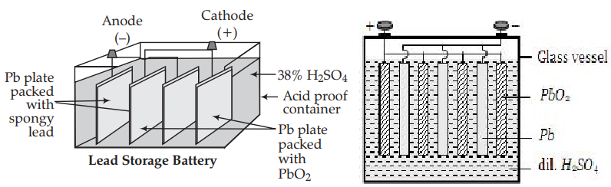

Slide 14
Description
The Lead – acid storage battery consists of three to six identical cells joined together in series.
Each of its cells has a lead anode (Pb) and lead dioxide (PbO₂) cathode.
A number of lead plates (anodes ‘–ve’ plates) are connected in parallel and a number of lead dioxide plates (cathodes ‘+ve’ plates) are also connected in parallel.
The lead plates fits in between the lead dioxide plates. The anodes and cathodes are separated from the adjacent ones by insulators like strips of wood (or) rubber (or) glass fiber sheets.
The entire combination is then immersed in 38% of sulphuric acid (H₂SO₄) having a density of 1.3 g / mL.
Anode: Lead (Pb) plate
Cathode: Lead dioxide (PbO₂)
Electrolyte: dil. Sulphuric acid (dil.H₂SO₄)
The cell may be represented as, Pb / PbSO₄ // H₂SO₄ / PbO₂ / Pb
A single cell generates 2 volt and six such cells in the battery produces a total of 12 volt.

Slide 15

Working
When the storage cell is operating as voltaic cell (ie., for supplying electrical energy), it is said to be discharging.
Discharging
At anode
Lead is oxidized to Pb²⁺ ions, which further combines with SO₄²⁻ ions forms insoluble PbSO4.

Slide 16

At cathode
The electrons released from the anode flows to dioxide electrode. Here PbO₂ gains electrons to form Pb²⁺ ions. In other words, lead undergoes reduction at the cathode from oxidation state +4 to +2. The Pb²⁺ ions then combine with SO₄²⁻ ions.

Slide 17


Slide 18
Recharging
When both anode and cathode become covered with PbSO₄, the cell stops its functioning. Recharging is done by applying a voltage across the electrodes that is slightly higher than the voltage (2V), the current will flow in the opposite direction, that is the battery can deliver. As the result lead sulphate gives lead and oxide. Pb is deposited on anode and PbO₂ is deposited on the cathode.
Net reaction during charging is:

Slide 19


Slide 20
Maintenance
If the lead – acid storage batteries are properly maintained in the following ways, they can function for long periods.
1. Avoid over discharging of the battery.
2. Maintain the electrolyte at the proper level by adding water (whenever required).
3. Keep the battery clean.
4. Avoid overheating the battery
Advantages
1. It is made easily.
2. It provides a large burst of current to the engine starter motor.
3. Reliable and has long life.
4. The self – discharging rate is low when compared to other rechargeable batteries.
5. It is effective at low temperatures

Slide 21
Disadvantages
1. These batteries tend to slowly self – discharge. It will be difficult to start a car when idle for several weeks.
2. When the temperature is very low, sulphuric acid becomes viscous, thereby inhibiting the flow of ions between the plates.
3. Corrosive and toxic substances are used.
4. Recycling of this battery causes environmental hazards.
Uses
1. Lead acid storage cell is used mainly in automobiles such as cars, buses, etc.
2. It is also used in gas engine ignition, telephone exchanges, hospitals, etc.,
3. As it is rechargeable, it is used in UPS (Uninterrupted Power Supply) a power system which maintains current flow without even a momentary break in the event of current failure.

Slide 22
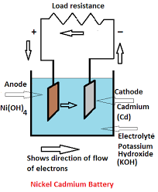
NICKEL – CADMIUM CELL (or) NICAD battery
Nickel – Cadmium cell is another important secondary battery. It is also a rechargeable battery.
Anode: Cadmium rod
Cathode: NiO₂ coated on nickel rod
Electrolyte: Potassium hydroxide (KOH)
The cell may be represented as, Cd / Cd(OH)₂ // KOH / NiO₂ / Ni
It produces a voltage of about 1.4 V

Slide 23
Working (during discharging)
During the operation of an NICAD battery, cadmium is oxidized to Cd²⁺ ions and insoluble Cd(OH)₂ is formed
At anode
Cadmium is oxidized to give Cd²⁺ ions and electrons. The Cd²⁺ ions react with OH⁻ ions to give insoluble Cd(OH)₂.
At cathode
Electrons are gained by NiO₂. Ni undergoes reduction from Ni⁴⁺ to Ni²⁺. This Ni²⁺ ions contribute with OH⁻ ions to give Ni(OH)₂.

Slide 24

Recharging
The recharging process is similar to lead – acid storage battery. Recharging is done by applying a voltage across the electrodes that is slightly greater than the voltage (1.4V), the current will flow in the opposite direction, that is the electrode reaction gets reversed. As a result, cadmium is deposited on anode and NiO₂ is deposited on the cathode

Slide 25

The overall cell reaction during discharging and charging is,
Advantages
1. It is comparatively smaller and lighter.
2. It has a longer life than a lead – acid storage battery.
3. It can be packed in a sealed container like a dry cell.
4. It does not use corrosive materials.
Disadvantages
1. It is more expensive than lead – acid storage battery.
2. Cadmium discarded in the environment, enters the human body and cause health problems

Slide 26
Uses
1. NICAD cells are commonly used in calculators, transistors, electronic camera flashes, rechargeable flash lights, etc.
2. The good low temperature performance has lead to wide use of NICAD batteries in aircraft and space satellite power systems
LITHIUM BATTERY
Lithium metal is attractive as a battery anode material because of its light weight, high voltage and good conductivity.
It is regarded as the battery of the future.
Lithium battery is a solid state battery, since a solid electrolyte is used instead of a liquid or a paste.
Description
It has a Lithium anode at one end, a TiS₂ (Titanium sulphide) cathode at another end and a solid electrolyte.
A solid electrolyte, normally a conductive polymer is packed in between the two electrolytes.
The conductive polymer (solid electrolyte) permits the passage of ions but not the electrons

Slide 27
Anode: Li
Cathode: TiS₂
Electrolyte: Conductive polymer (solid)
The cell may be represented as, Li / polymer / TiS₂
The cell is rechargeable and produces a cell voltage of 3 V

Slide 28

Working (Discharging)
Cell reaction: Li + TiS₂ Li ⁺ + TiS₂⁻
and Li⁺ + TiS₂⁻ Li Ti S₂
Recharging
The Lithium battery can be recharged by supplying an external current, that is slightly greater than the voltage (3 V), which drives the Lithium ions back to the anode.
Li Ti S₂ Li⁺ + TiS₂⁻

Slide 29
Several other types of secondary lithium batteries are also known; the Li / MnO₂, Li / V₂O₅, Li / MoO₂ and Li / Cr₃O₈ are some among these.
Advantages
The lithium battery is considered to be the cell of the future because,
1. Lithium is a light weight metal, only 7 g required for produce one mole of electrons.
2. Its cell voltage is high, 3 V.
3. Lithium has the most negative Eº value (-3.01 V) and therefore generates a higher voltage than the other types of cells.
4. The energy output of a lithium cell is 2 – 4 times better than that of conventional zinc anode batteries.
5. Many of the lithium cells will perform over a temperature range of 40 – 70 °C.
6. All the constituents of the battery are solids and hence there is no risk of leakage from the battery.
7. It can be made into conventional shapes and sizes.

Slide 30
Disadvantages
1. Lithium battery is more expensive than other batteries.
2. Early versions of a lithium battery had a short life and variable outputs.
Uses
Button sized lithium batteries are used in calculators, watches, cameras, mobile phones, laptop computers, etc.,

Slide 31
FUEL CELL:
It is a device in which the chemical energy of the fuel hydrogen is directly converted into electricity without combustion.
Fuel + Oxygen Oxidation Product + Electricity
Eg: H₂-O₂ fuel cells\

Slide 32
H₂-O₂ FUEL CELL:
It consists of two porous electrodes anode and cathode.
Two porous electrodes – Made of compressed carbon containing a catalyst like Pt/Pd.
In between two electrodes an electrolytic solution 25% KOH or NaOH filled.
When H₂ is bubbled through the anode compartment, where it is oxidized.
The O₂ is bubbled at the cathode compartment where it is reduced.
Anode :Hydrogen
Cathode :Oxygen ( oxidizer)
Electrolyte :25% KOH or NaOH

Slide 33
Working At Anode:
The hydrogen gas is bubbled through the anode compartment
It undergoes oxidation by liberation of electrons and combines with OH⁻ to form H₂O
Cell reaction: 2H₂ + 4OH⁻ 4H₂O + 4e⁻
At Cathode:
The oxygen is bubbled through the cathode compartment.
The electron produced at the anode pass through the external wire to the cathode where it is absorbed by O₂ and H₂O to produce OH⁻ ions.
Cell reaction: O₂ + 2H₂O + 4e⁻ 4OH⁻

Slide 34
Over all cell reactions
At Anode: 2H₂ + 4OH⁻ 4H₂O + 4e⁻
At Cathode: O₂ + 2H₂O + 4e⁻ 4OH⁻
2H₂O
Overallcellreaction:2H₂+O₂
The standard emf of the hydrogen-oxygen fuel cell is 1.23 V

Slide 35
Merits:
i. High efficiency (more than 75%)
ii. No unwanted noise and less maintenance.
iii. No pollution – emits only water vapour
iv. No need to change electrode often.
Limitations:
H₂ gas is explosive
It is very expensive to be carried out
H₂ is a gas, it is difficult to compress into liquid form
Uses:
i. Used in military vehicles and space vehicles.
ii. H₂ – O₂ fuel cell, the product is water, so no need of fuel because fuel is water.

Slide 36
MICROBIAL FUEL CELLS:
A microbial fuel cell (MFC) is a device that converts chemical energy to electrical energy by the action of microorganisms.
These electrochemical cells are constructed using either a bioanode and/or a biocathode (catalytic reaction of micro organisms)
Bio-electro chemical system
Mimics bacterial interaction
Based on redox reaction
Harness the natural metabolism of microbes to produce electricity
Bacteria covert substance into electrons
Electrons run through the circuit to generate power

Slide 37
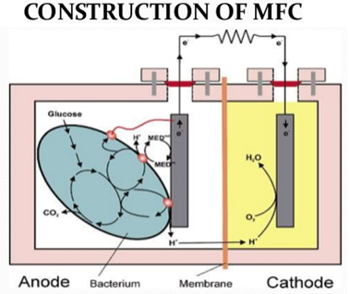

Slide 38
Components
Anode
Cathode
Exchange membrane
Substrate
Electrical circuit
Microbes
The electrons from the cathode combine with dissolved oxygen and the H+ ions to form pure H₂O.
The H+ ions flow through the semi-permeable membrane to the cathode. This process is driven by the electro-chemical gradient resulting from the high concentration of H⁺ ions near the anode.
The electrons flow up from the anode, through a wire, and onto the cathode. While flowing through the wire, an electrical current is generated that can be used to perform work.

Slide 39
The electrons flow from the bacteria to the anode, sometimes assisted by a mediator molecule.
When microorganisms consume a substance such as sugar in aerobic conditions, they produce carbon dioxide and water. However, when oxygen is not present, they produce carbon dioxide, hydrons (hydrogen ions), and electrons, as described below
C₁₂H₂₂O₁₁ + 13H₂O → 12CO₂ + 48H⁺ + 48e⁻
Microbial fuel cells use inorganic mediators to tap into the electron transport chain of cells and channel electrons produced.
Potential mediators include natural red, methylene blue, thionine, and resorufin
Organisms capable of producing an electric current are termed exoelectrogens. In order to turn this current into usable electricity, exoelectrogens have to be accommodated in a fuel cell

Slide 40
Applications:
Used in Waste water treatment
Power generation
Bio-Sensors
Advantages of MFC
Generation of energy out of bio waste / organic matter
Direct conversion of substrate energy to electricity
Omission of gas treatment
Aeration
Bioremediation of toxic compounds
Limitations of MFC
Low power density
High initial cost
Activation losses
Bacterial metabolic losses

Slide 41
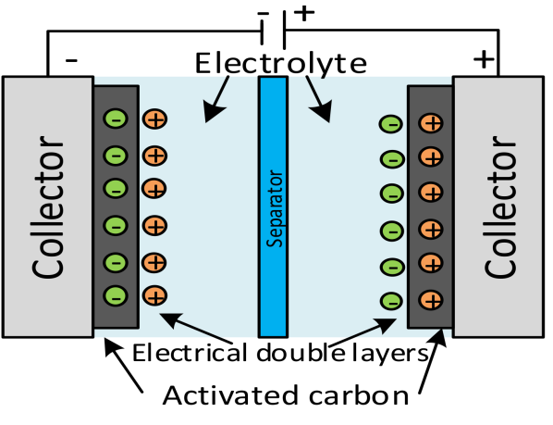
SUPER CAPACITOR
It is a high capacity capacitor.
They store 10 to 100 times more energy per unit volume and deliver charge much faster than batteries.
Super capacitor use electrostatic double layer capacitance
Design of super capacitor:
It consists of two electrode separated by an ion permeable membrane and dipped in an electrolyte containing positive and negative ion connecting both the electrodes

Slide 42
Working
When the electrodes are connected to the power source, ions in the electrolyte form electric double layer (Helmholtz electric double layer) of opposite polarity to the electrodes polarity, creating an electric fields between them.
The positively polarized electrodes will have a layer of negative ions at the electrode / electrolyte interface.
Similarly the negatively polarized electrode will have a layer of positive ions t the electrode / electrolyte inter face.
The electric field polarizes the dielectric
It stores more electrical energy at an electrode / electrolyte interface
Advantages
It is highly safe
Life time is very high (10 – 20 years)
Can be cycled millions of time
It can be charge in seconds
It provides high power density and high load currents

Slide 43
Disadvantages
Cost per watt is high
It cannot be used as source for continuous power supply
It should be connected in series for high voltage
High self-discharge
Applications
Voltage stabilization in start/stop system
Energy harvesting
Kitchen appliances
Wind energy
Utility meters
Consumer electronics
Remote power for sensors, LEDs, switches
Energy efficiency and frequency regulation

